Slide 1
Family Mobility, Third Culture Kids & Mental Health
EUFASA Conference, Madrid, June 2023
Katja Herrmann Aegerter, katja.herrmannaegerter@unibas.ch
University of Basel
Faculty of Psychology
Division of Clinical Psychology and Psychotherapy
Missionsstrasse 60/62
4055 Basel, Switzerland
psycho.unibas.ch

Slide 2
Agenda.
1 | Introduction – who am I and what is Home Abroad
2 | Third Culture Kids – what are they?
3 | State of Research – how are they doing?
4 | Advice – how can parents help?
5 | Thank you

Slide 3
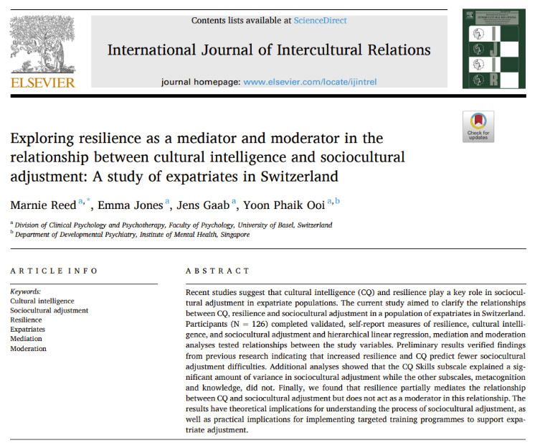
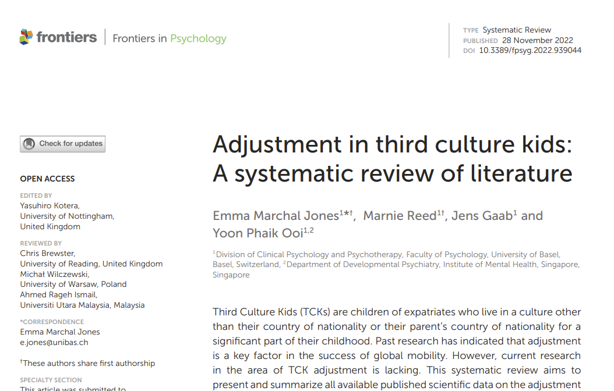
Introduction
Basel University Website. Home Abroad Team.
Basel University Website. Home Abroad Project.
Notes:
Let´s begin.
My name is Katja Herrmann Aegerter and due to my husband´s career with the Swiss Foreign Service, I have left my home country of Germany 16 years ago and have never looked back. Life and career took us to postings in Washington DC, Bern (Switzerland), Bishkek (Kyrgyzstan) and now Skopje (North Macedonia). Along the way, we have not only added two family members (one of which is a true Washingtonian) but I have made a career change and studied psychology. My Master thesis already treated the topic of Third Culture Kids and their experience during their mobile childhood years. At this point, I am nearing the end of my 2nd Ph.D. year in the Home Abroad Program at the faculty for Clinical Psychology and Psychotherapy of Basel University, Switzerland.
The Home Abroad program came to life thanks to two colleagues of mine, who worked as counsellors at an Expat Clinic in Basel, which is part of the University Psychotherapy Center. Basel has a high number of expats due to the pharma sector being located there. In the Expat clinic, my colleagues, who are specialised on treating children and adolescents observed patterns in the children who moved to Switzerland due to the parental careers. Based on the reality they saw in the clinic, they wanted to investigate the causes for these particular challenges of those children. So far, they have successfully published 2 articles, 4 more are currently accepted by journals or under review and should be published very soon. I am currently working on two more articles and will in total in the frame of my phd be publishing 3-4 articles on this topic.

Slide 4
Agenda.
1 | Introduction – who am I and what is Home Abroad
2 | Third Culture Kids – what are they?
3 | State of Research – how are they doing?
4 | Advice – how can parents help?
5 | Thank you

Slide 5
2 Third Culture Kids – What are they?
Definition
“A person who spends a significant part of his or her first eighteen years of life accompanying parent(s) in a country that is different from at least one parent‘s passport country(ies) due to a parent‘s choice of work or advanced training.” (Pollock, Van Reken, Pollock, 2017)
3 CULTURES
Home Culture
1st
TCK Culture 3rd
Host Culture 2nd

Slide 6
2 Third Culture Kids – What are they?
Importance of understanding TCKs
MOBILE CHILDHOODS
common
beneficial
challenges - immediate or long-term
mental well-being impact - immediate or long-term
INFORMATION AND PREPARATION
navigation
empowerment
risk reduction

Slide 7
2 Third Culture Kids – What are they?
Chances of TCKs
Expanded Worldview
3D-Worldview
Resilience (with the help of caregivers)
Adaptability & Blending in
Linguistic, Social and Cross-Cultural Skills
Open-mindedness
High-standard education
Many global friendships
Challenges of TCKs
Separation, Loss & Grief
Relationships (Family, Peers)
Roots & Belonging
Identity
Adverse Childhood Experiences (ACEs) – little academic research
Stress
Trauma – little academic research

Slide 8
Agenda.
1 | Introduction – who am I and what is Home Abroad
2 | Third Culture Kids – what are they?
3 | State of Research – how are they doing?
4 | Advice – how can parents help?
5 | Thank you

Slide 9
3 State of Research – how are they doing?
Emotional Development
Adjustment
Struggles of adjusting and fitting in home/passport countries
Adjustment difficulties navigating activities of daily living
Difficulties forming friendships
Being bullied
Particularly difficult when transitioning into college life
Mental Well-Being
Psychological impact of the TCK experience not to be understated
Lonelineness, distress, psychological challenges (depression, anxiety, stress, anger upon re-entry)
Re-entry programs: effective interventions (40% reduction in depression, anxiety, stress levels)
Lower self-esteem due to cultural homelessness: buffered by affirmation, belonging and committment
Emotional and mental health affected by the preparation TCKs receive

Slide 10
3 State of Research – how are they doing?
Emotional Development continued
Grief and Loss
Significant losses and grief experiences: leaving, multiple goodbyes
Unresolved grief: disenfranchised/hidden losses
Losses relate to people, pets, possessions
Existential losses tied to identity and home
Processed and resolved grief significantly affects TCKs emotional well-being
Social/Relational Development
Friendships/relationships
Challenge: Forming-losing-reforming of friendships & maintenance of friendships
Friendships as one of numerous TCK issues
Friendship difficulties when repatriating
Characteristics of TCK friendship building: socially-connected, emotionally-connected, functionally-connected: TCKs chose form of relationship with least emotional investment (socially-connected or functionally-connected)

Slide 11
3 State of Research – how are they doing?
Social/Relational Development continued
Intercultural sensitivity/competence
TCKs significantly higher social sensitivity
Competent intercultural communicators (despite struggles with sense of belonging)
Tolerance/attitude towards other cultures/religions
TCKs more tolerant views toward other cultures
Religious tolerance with desire that all religions would be treated fairly
TCKs as cultural hybrids: TCK worldview orientation capable of holding 2 polarities – ethnocentric and ethnorelative

Slide 12
3 State of Research – how are they doing?
Identity Development
Belongingness & Home
Prominent theme in TCK literature
Fit in with many groups but lack belonging to any
Primary sense of belonging with other TCKs or in multicultural settings (settings which normalize unconventional identity of TCKs)
Home associated with friends and family (less a geographical location)
Higher cultural homelessness associated with lower self-esteem, buffered by affirmation, belonging and committment
Identity Negotiation
Multiple identities and feeling accepted in 2 or more cultures: adaptation by shifting identities depending on circumstances
Challenge: not feeling a strong sense of belonging with desire to belong somewhere
Frequent transitions might disrupt and slow TCKs process of identity development due to lack of stable reference point (impact on psychological well-being)

Slide 13
3 State of Research – how are they doing?
Identity Development continued
Cultural Identification
TCKs most comfortable with individuals who share similar international experience
TCK group identity: shared experience from international setting (not typical cultural identification eg. Location, race other categories)
Identity: in-between culture or third culture
TCKs: multicultural identity rather than shifting or confused identities
Identity Strategies
Reading and writing as support tool to help TCKs navigate identity-building
Self-help

Slide 14
3 State of Research – how are they doing?
Specific challenges
Children´s confusion about their role as a result of being raised in different cultures (Rosenbusch, & Cseh, 2012)
Young children: loss of home and social network, change of schools, making new friends, learning a new language (Pollari and Bullock, 1988; McLachlan, 2008; Lazarova et al., 2015)
Feelings of uncertainty, sense of belonging to a culture and identity loss (Ali, 2003; Moore and Barker, 2012; Rosenbusch and Cseh, 2012)
Important risk factors for adjustment problems
(Ali, 2003; Van der Zee et al., 2007):
Emotional instability
Ambivalent attachment style
Notes:
Now what are the specific challenges?

Slide 15
3 State of Research – how are they doing?
Adolescent Development Theory & Third Culture Kids
Unique challenges of adjustment to foreign environment (Weeks, et al., 2010):
Disruption of the identity formation process during adolescence
Concerns related to making friends
Fitting in
Performance in schools
Standing out in host culture because of appearance and behaviours
Resources of TCKs
Open-mindedness as key to adjustment (Weeks, et al., 2010)
Secure attachment, emotional stability, high level of social initiative fostered adjustment (Ali, 2003; Van der Zee et al., 2007)
Experience with different situations and people makes it easier for TCKs to adapt to new situations and interact with different people (Moore and Barker, 2012)
Notes:
If we look at adolescents, what can be their unique struggles?

Slide 16
3 State of Research – how are they doing?
Crossover effects
Expatriates work satisfaction positively affects children´s adjustment (Van der Zee, et al., 2007)
Effective adjustment of adolescents might lead to longer stays abroad for expatriate family (Weeks, et al., 2010)
Little knowledge on the extent of link between demands for children and adjustment of parents (Sterle, et al., 2018)
Crossover effects of family stress to children need to be acknowledged and addressed by the family (Lazarova, et al., 2015).

Slide 17
3 State of Research – how are they doing?
Family Resources
(1) Family adaptability
(2) Family cohesion:
Strongest predictor of quality of life and sociocultural adjustment of expat children and adolescents (Van der Zee, et al., 2007)
Impact children´s ability to establish and maintain friendships with other children in host country (Caligiuri et al., 1998)
Emotional support/good discussions, parental sensitivity towards child´s specific needs in host country: important facilitators in adjustment process (Caligiuri et al., 1998)
(3) Family communication: creates a shared sense of meaning, develop and orchestrate coping strategies and maintain harmony and balance (Van der Zee, et al., 2007)
Social Resources
Friends (school), peers who speak their mother tongue (isolation from host culture less of a problem) (Weeks et al., 2010)
Family support and informal networks buffer against depressive symptoms and increase academic performance and persistence (Lucier-Greer et al., 2015)
Notes:
What does research state about the resources of families?
And social resources

Slide 18
Agenda.
1 | Introduction – who am I and what is Home Abroad
2 | Third Culture Kids – what are they?
3 | State of Research – how are they doing?
4 | Advice – how to help?
5 | Thank you
Notes:
Let me get to the last part of my presentation: how can parents help?

Slide 19
4 Advice – How to help?
PREVENTION
Education for Parents
Parental Mental Health
Support through parents
Education for TCKs
Preparation of Families
Support through employers

Slide 20
4 Advice – How can parents help?

Slide 21
4 Advice – How can parents help?
PREDICTABILITY
Transparency and open communication (age-appropriate, at eye level)
Continuity through school systems / school language
Continuity through a home base
Maintain routines and traditions
Involvement (giving them agency will make them feel important, equal & heard)
→ The bigger their involvement the higher their compromise tolerance.

Slide 22
4 Advice – How can parents help?
FAMILY
Proactive parenting
Solid attachment
Cohesive and democratic family environment
Parental presence and availability (both parents)

Slide 23
4 Advice – How can parents help?
RELATIONSHIPS
Maintenance of relationships with extended family (e.g. grandparents, cousins, etc.).
Maintenance of friendships
Model the maintenance of distant friendships
Allow mingling with like-minded individuals.
Model and teach openness

Slide 24
4 Advice – How can parents help?
ATTITUDE
Space & time to grieve
Own attitude
Proper goodbye (RAFT)
Perfect balance as a parent (professionally and mentally)
Time transitions
Validate child´s stressor
Accept your child´s cultural mix

Slide 25
Agenda.
1 | Introduction – who am I and what is Home Abroad
2 | Third Culture Kids – what are they?
3 | State of Research – how are they doing?
4 | Advice – how can parents help?
5 | Thank you

Slide 26
Thank you for your attention.
Please do not hesitate to reach out to me:
Katja.herrmannaegerter@unibas.ch

