Slide 1
EUFASA Working Group Children
Multilingualism / Identity
EUFASA Conference Brussels 2024
EUFASA AISBL - European Union Foreign Affairs Spouses Partners and Families Association

Slide 2
WG CHILDREN
Manuela Caramujo (co-chair), PT
Revaldo Walters (co-chair), UK
Maria Devolx, BE
Petra Horakova Kristofova, CZ
Liliam Pallum, EE
Elisabeth Riecken, AT
Anna Shrubsole, UK
EUFASA AISBL - European Union Foreign Affairs Spouses Partners and Families Association

Slide 3
Multilingualism
“The ability of societies, institutions, groups and individuals to engage, on a regular basis, with more than one language in their day-to-day lives” (European Commission, 2007: 6).
Source: International Encyclopedia of Education (Fourth Edition), 2023
Social language (family and friends) / academic language
Impact on children
Mental health of children
IS an important topic.

Slide 4
Perks and challenges of multilingual kids

Slide 5
Key findings in testimonials
Some statistics:
80% felt most at home in a specific country.
70% spoke multiple languages in their homes.
87% express a desire to continue their education in different countries.
90% leaned towards English as their primary language
of communication.
Multilingualism offers numerous advantages.
It presents unique challenges that shape the experiences and aspirations of our diplomatic children.
Understanding and supporting their linguistic journey is crucial for promoting their full development and facilitating successful transitions across diverse cultural landscapes.

Slide 6
Countries of good practices on language support
Country | Are language classes offered? | How useful would the classes be?
Austria | No languages courses are offered for children | There's a potential need for courses, which will be discussed further
Belgium | The MFA sponsors language classes with a budget for children until the last year of high school. | Learning national languages is considered crucial for integration upon returning to Belgium.
Czechia | No language classes are offered due to resource limitations. | Online learning of the native language (Czech) is suggested, but not a high priority.
Estonia | Free Estonian language courses are supported through various state-provided programs. The MFA supports the annual Estonian language summer camps. | Parents are encouraged to sign up their children to free Estonian language online courses sponsored by the Ministry of Education. Foreign language classes are covered by the MFA at posting if assigned by the school abroad.

Slide 7
Country | Are language classes offered? | How useful would the classes be?
France | No. Families are encouraged to apply to the CNED (Centre National d'éducation à distance) which provides a wide range of interactive online language classes. These courses charge fees. | An extra allowance would be beneficial for language classes in the event of a family requesting specific language instruction if a child is unable to benefit from this curriculum on post.
Germany | No language classes are provided, but costs for additional lessons can be reimbursed upon request. | Offering language classes for children is not considered a high priority due to limited benefits.
Ireland | Language classes in any official language of the receiving country are offered. | Children can access classes both while on posting and at home, with funding available.
Latvia | Limited availability for Latvian language training through the Latvian Language Agency. No foreign language classes provided. | Latvian language training is considered beneficial, but resources are limited. Online training provided for the state language.

Slide 8
Country | Are language classes offered? | How useful would the classes be?
Portugal | Yes, Portuguese classes are offered to Portuguese children in 37 countries. Other countries are under consideration. | Portuguese language classes are crucial for maintaining language proficiency. Availability varies based on educational agreement and online resources.
Slovenia | The Ministry of Education sponsors Slovenian language lessons organized by the Institute for Education. | Children have access to classes while on posting, with additional lessons offered upon returning home.
Spain | No language classes are offered, despite requests. | Classes on post would be beneficial, especially in difficult language countries.
Switzerland | The MFA doesn't offer language classes for children but reimburses costs for German, French lessons if not available in schools abroad. | Language classes are deemed less necessary due to existing language education systems in Switzerland.
United Kingdom | No. | English language proficiency is presumed due to its global prevalence. International English-speaking schools are common overseas.

Slide 9
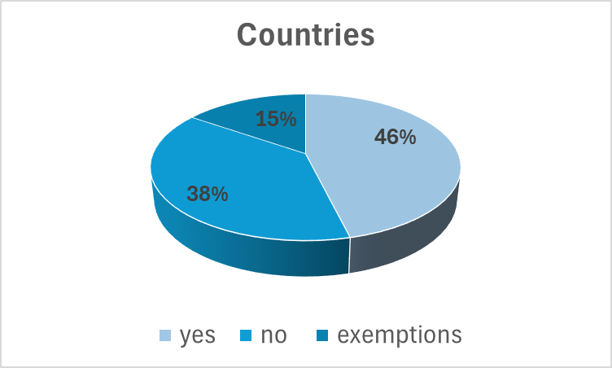
Good practices statistics

Slide 10
Recommendations to MFA’s
The EUFASA strongly recommend the MFA’s to improve the access to language education for diplomatic children, especially to facilitate their integration upon returning to their home countries.
As the MFA’s usually do for officials and their spouses, the EUFASA strongly recommend the MFA’s to provide access to language training for diplomatic children when moving abroad, especially to facilitate their integration upon arriving to a new country.

Slide 11
Q & A

Slide 12
wgchildren@eufasa.org
Get In Touch
With WG Children
Thank you for your attention!

