Slide 1
Improving information for diplomatic families who have children with disabilities and different needs
Mobility of Children with Special Needs Working Group
May 2022

Slide 2
The Working Group
Amanda Neil, UK (Chair)
Melissa Woods Nelson, Switzerland
Petra Horáková Krištofová, Czech Republic
Manuela Caramujo, Portugal

Slide 3
Who we are
As a group we’ve navigated…
16 countries
6 children with additional needs including:
Autism
Cerebral Palsy
Down’s Syndrome
ADHD
Social Pragmatic Communication Disorder
Dyspraxia
Depression and self harming

Slide 4
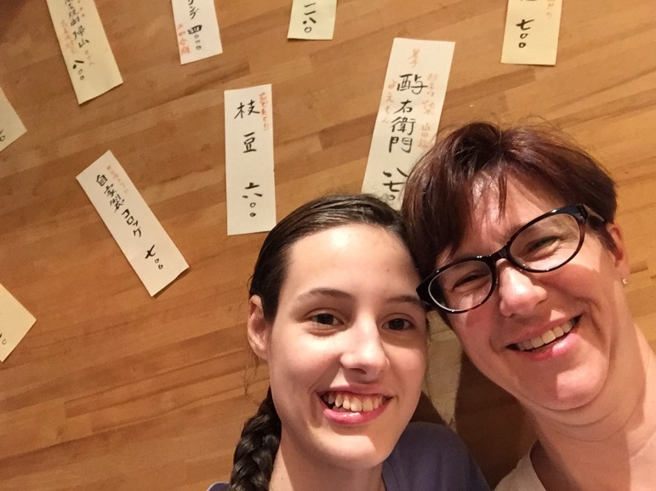
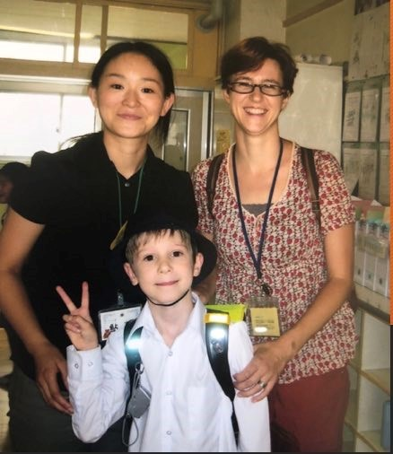
Melissa, Alex and Mady

Slide 5
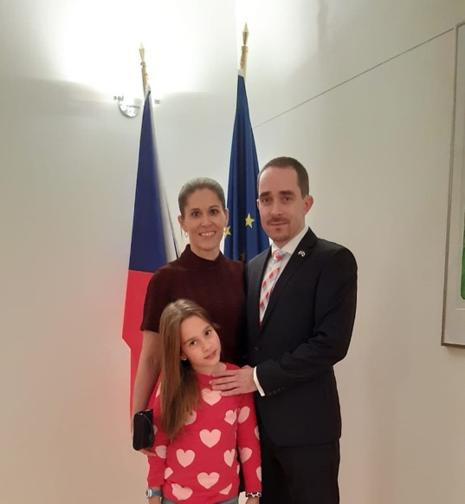
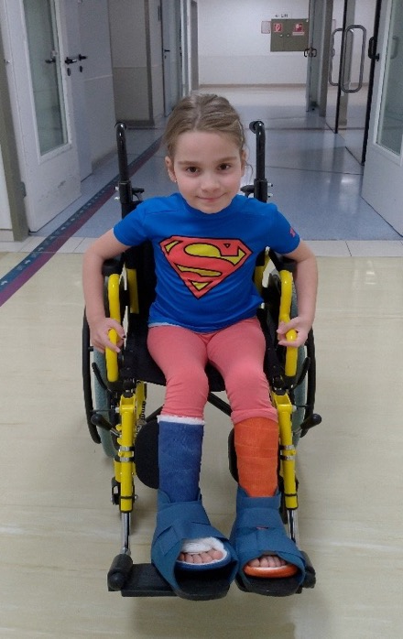
Petra and Johanka

Slide 6
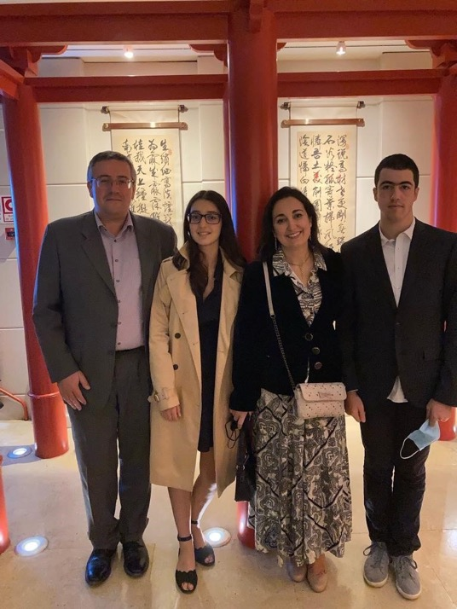
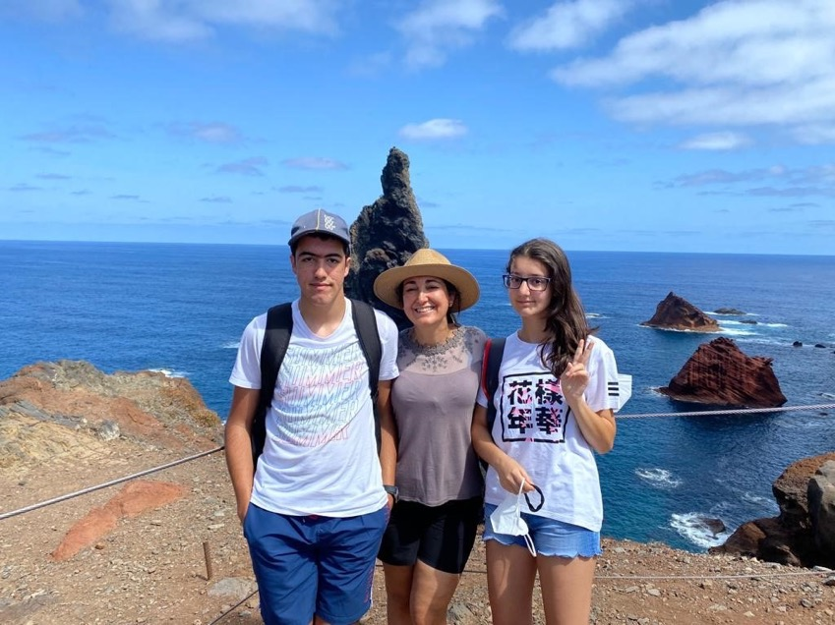
Manuela and Alexandre

Slide 7
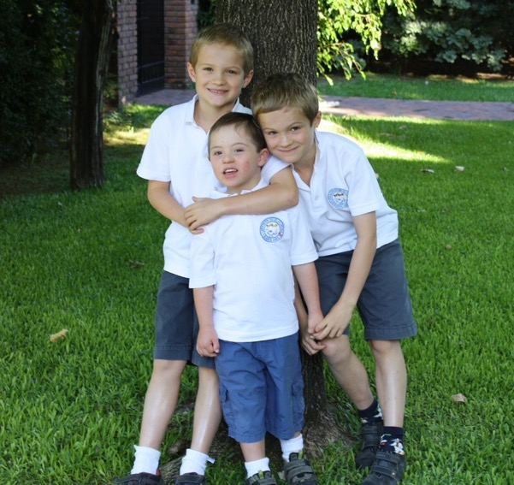
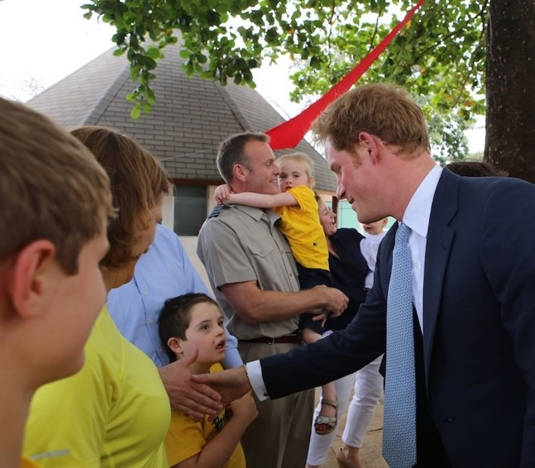
Amanda and Matthew

Slide 8
How much do you know about disability and different needs?
Notes:
Speaker to discuss:
Visible disabilities
Invisible issues (notes, autism, dyspraxia,eating disorders, mental health issues, learning differences)
Does anyone have a family member with a disability or invisible issue?
Do you have families at post who have a family with a disability
It can happen to anyone at any time

Slide 9
Hidden disability?

Slide 10
Hidden disability?

Slide 11
There is very little information out there!
We wanted to produce something that…
Shares practical information and best practice
Is specific to foreign service families
Encourages adequate preparation and maximum flexibility
… and could be easily updated

Slide 12
… So we put together practical tips and experience on:
Understanding children’s needs
Finding and assessing schools
Finding therapists & specialists
Finding creative solutions
Navigating medications
Potential problems, etc.

Slide 13
Finding & assessing schools

Slide 14
Specialists & medications

Slide 15
Thinking creatively and planning ahead

Slide 16
Recommendations to MFAs
Provide diplomatic families with a Family Office or designated MFA employee /office for basic information and support
If this is not possible, ensure other mechanisms are in place to provide support and information
Take needs into consideration in international transfers
Provide adequate financial support to allow families to go abroad
Be open to discussing creative solutions

Slide 17
A note about language…
The right language is essential, but challenging
Disability and neurodiversity communities do not always agree
Community norms vary from place to place and with language
Person-first vs. identity-first language
Not all feel they have a “disability” or “special needs”
Most important: how people with different needs identify

Slide 18
Next steps
Please share and distribute the booklet
Future updates
Working group on children next year?

Slide 19
Good preparation helps kids thrive!
“Since Matthew’s arrival at EAB, he has not only been a beacon of optimistic energy but a unifying presence… It is Matthew’s departure that will diminish our collective learning experiences, positive energy and the quality of our school.”

Slide 20
Thank you!

